Slide 1

Consumer Behavior: Buying, Having, and Being
Twelfth Edition
Chapter 2
Consumer and Social Well-Being
Copyright © 2017, 2015, 2013 Pearson Education, Inc. All Rights Reserved.
Notes:
If this PowerPoint presentation contains mathematical equations, you may need to check that your computer has the following installed:
1) MathType Plugin
2) Math Player (free versions available)
3) NVDA Reader (free versions available)
This chapter defines the scope of international business and introduces us to some of its most important topics.

Slide 2
Learning Objectives
2.1 Ethical business is good business.
2.2 Marketers have an obligation to provide safe and functional products as part of their business activities.
2.3 Consumer behavior impacts directly on major public policy issues that confront our society.
2.4 Consumer behavior can be harmful to individuals and to society.

Slide 3
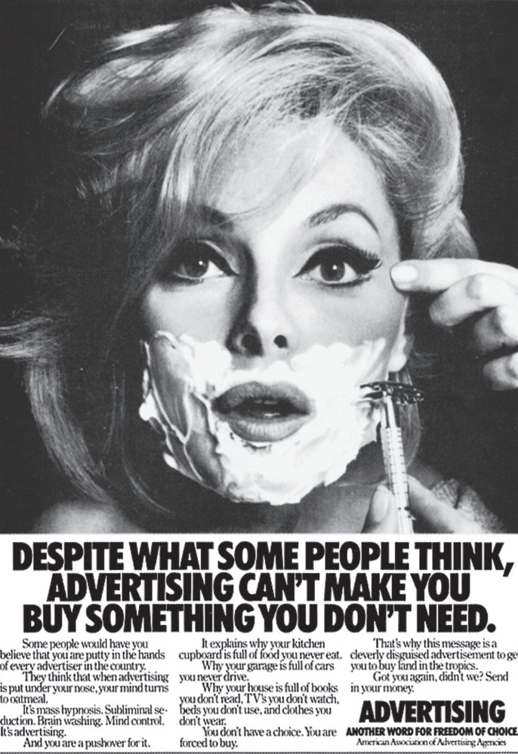
Learning Objective 2.1
Ethical business is good business.

Slide 4
Marketing Ethics and Public Policy
Business ethics are rules of conduct that guide actions in the marketplace
There are cultural differences in what is considered ethical.
Notes:
It can be difficult to avoid ethical conflicts because our thoughts of what is right and wrong vary among people, organizations, and cultures. These cultural differences certainly influence whether business practices such as bribery are acceptable. Bribing foreigners to gain business has been against the law in the
United States since 1977, under the Foreign Corrupt Practices Act. The Organization for Economic Cooperation and Development (OECD), to which most industrialized countries belong, also outlaws bribery. Still, these practices are common in many countries.

Slide 5
Needs and Wants
Consumerspace
Materialism
Provenance
Curation
Notes:
Consumerspace is an environment where individuals dictate to companies the types of products they want and how, when, and where (or even if) they want to learn about those products.
Materialism refers to the importance people attach to worldly possessions.
One important dimension today is provenance: Shoppers are willing to pay more for an item when they know exactly where it comes from, and they are assured that “real people” have
thoughtfully selected the things from which they choose.
Curation refers to an expert who carefully chooses pieces to include in a museum exhibit, now applies to a range of consumer products such as food, clothing, and travel.

Slide 6
Do Marketers Manipulate Consumers?
Advertisers simply do not know enough about people to manipulate them
Notes:
The failure rate for new products ranges from 40-80%. Although people may think that advertisers use magic to sell products, marketers are only successful when they promote good products.

Slide 7
Do Marketers Create Artificial Needs?
Objective of marketing: create awareness that needs exist, not to create needs
Need: a basic biological motive
versus
Want: one way that society has taught us that the need can be satisfied
Notes:
Marketing is commonly criticized as trying to convince consumers that they need something when they really don’t. This is an ethical issue. Marketers respond to this question by pointing out that the need already exists in the consumer, but marketers recommend ways to satisfy the need.

Slide 8
Sample of Federal Legislation Intended to Enhance Consumers’ Welfare (1 of 2)
Table 2.1 Sample of Federal Legislation Intended to Enhance Consumers’ Welfare
Year | Act | Purpose
1953 | Flammable Fabrics Act | Prohibits the transportation of flammable fabrics across state lines.
1958 | National Traffic and Safety Act | Creates safety standards for cars and tires.
1958 | Automobile Information Disclosure Act | Requires automobile manufacturers to post suggested retail prices on new cars.
1966 | Fair Packaging and Labeling Act | Regulates packaging and labeling of consumer products. (Manufacturers must provide information about package contents and origin.)
1966 | Child Protection Act | Prohibits sale of dangerous toys and other items.
1967 | Federal Cigarette Labeling and Advertising Act | Requires cigarette packages to carry a warning label from the Surgeon General.
1968 | Truth-in-Lending Act | Requires lenders to divulge the true costs of a credit transaction.
1969 | National Environmental Policy Act | Established a national environmental policy and created the Council on Environmental Quality to monitor the effects of products on the environment.
1972 | Consumer Products Safety Act | Established the Consumer Product Safety Commission to identify unsafe products, establish safety standards, recall defective products, and ban dangerous products.

Slide 9
Sample of Federal Legislation Intended to Enhance Consumers’ Welfare (2 of 2)
[Table 2.1 continued]
Year | Act | Purpose
1975 | Consumer Goods Pricing Act | Bans the use of price maintenance agreements among manufacturers and resellers.
1975 | Magnuson-Moss Warranty Improvement Act | Creates disclosure standards for consumer product warranties and allows the Federal Trade Commission to set policy regarding unfair or deceptive practices.
1990 | The Nutrition Labeling and Education Act | Reaffirms the legal basis for the Food and Drug Administration’s new rules on food labelling and establishes a timetable for the implementation of those rules.
1998 | Internet Tax Freedom Act | Established a moratorium on special taxation of the Internet, including taxation of access fees paid to America Online and other Internet Service Providers.
2010 | Dodd-Frank Wall Street Reform and Consumer Protection Act | Prompted by the recession that began in 2008, intends to promote the financial stability of the United States by improving accountability and transparency in the financial system, to end “too big to fail,” to protect the American taxpayer by ending bailouts, and to protect consumers from abusive financial services practices.

Slide 10
Are Advertising and Marketing Necessary?
Does advertising foster materialism?
Products are designed to meet existing needs
Advertising only helps to communicate their availability
Notes:
Yes, we can say that advertising and marketing are necessary because consumers may not know that solutions to problems exist without the information provided by advertising and marketing. This is the view of the economics of information perspective. It points out that there is an economic cost to searching for information. Advertising helps consumers by reducing search time.

Slide 11
For Reflection (1 of 4)
Advertisers are often blamed for promoting a materialistic society by making their products as desirable as possible. Do you agree with this?
Do you agree with this?
If yes, is materialism a bad thing?
If no, what are your reasons?

Slide 12
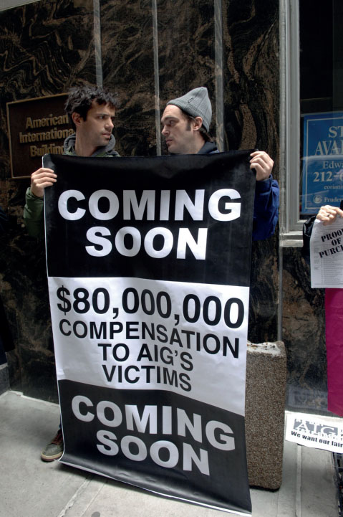
Learning Objective 2.2
Marketers have an obligation to provide safe and functional products as part of their business activities.

Slide 13
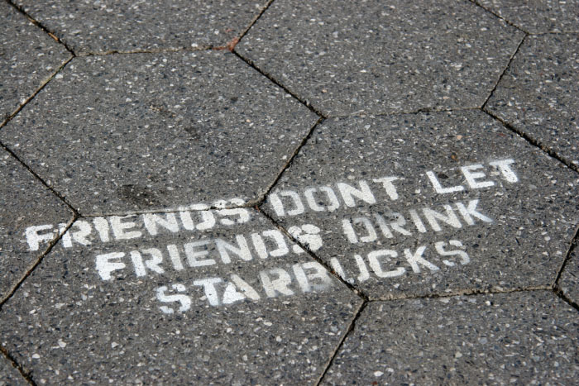
Courses of Action
Voice
Private
Third-Party Response
Notes:
When brands fail to satisfy, consumers have three options: 1) a voice response, 2) a private response, and 3) a third-party response. A voice response means complaining. A private response means sharing your dissatisfaction with friends. The third-party response may mean taking legal action or going through an organization like the Better Business Bureau.

Slide 14
Consumers’ Rights and Product Satisfaction
Market Regulation
Corrective advertising
Consumerism
Culture jamming
Notes:
Corrective advertising means that the company must inform consumers that previous messages were wrong or misleading.
Culture jamming culture jamming is a strategy to disrupt efforts by the corporate world to dominate our cultural landscape.

Slide 15
U.S. Regulatory Agencies and Responsibilities
Table 2.1 U.S. Regulatory Agencies and Responsibilities
Regulatory agency | Responsibilities
Consumer Product Safety Commission (CPSC) | Protects the public from potentially hazardous products. Through regulation and testing programs, the CPSC helps firms make sure their products won’t harm customers.
Environmental Protection Agency (EPA) | Develops and enforces regulations aimed at protecting the environment. Such regulations have a major impact on the materials and processes that manufacturers use in their products and thus on the ability of companies to develop products.
Federal Communications Commission (FCC) | Regulates telephone, radio, and television. FCC regulations directly affect the marketing activities of companies in the communications industries, and they have an indirect effect on all firms that use broadcast media for marketing communications.
Federal Trade Commission (FTC) | Enforces laws against deceptive advertising and product labeling regulations. Marketers must constantly keep abreast of changes in FTC regulations to avoid costly fines.
Food and Drug Administration (FDA) | Enforces laws and regulations on foods, drugs, cosmetics, and veterinary products. Marketers of pharmaceuticals, over-the-counter medicines, and a variety of other products must get FDA approval before they can introduce products to the market.
Interstate Commerce Commission (ICC) | Regulates interstate bus, truck, rail, and water operations. The ability of a firm to efficiently move products to its customers depends on ICC policies and regulation.
Notes:
Some of the US regulatory agencies are listed in the slide. Others and their specific responsibilities are provided in Table 4.3.

Slide 16
Transformative Consumer Research
TCR promotes research projects that include the goal of helping people or bringing about social change
Social marketing strategies use marketing techniques to encourage positive behaviors such as increased literacy and to discourage negative activities such as drunk driving

Slide 17
Social Marketing and Corporate Social Responsibility (CSR)
Social Marketing encourages positive behavior and discourages negative activities.
CSR is the process of encourage organizations to make a positive impact on stakeholders
Cause marketing is a strategy that aligns businesses with a cause.
Notes:
Social marketing strategies use the techniques that marketers normally employ to sell beer or detergent to encourage positive behaviors such as increased literacy and to discourage negative activities such as drunk driving.
Cause marketing example of Toms Shoes “One for One”

Slide 18
Top Cause Marketers
Yoplait
Susan G Komen
General Mills
P&G
RED
Boxtops for Education
Kellogg’s
Campbell’s
Girl Scouts
Dawn

Slide 19
For Reflection (2 of 4)
Do you purchase a certain product because of their cause? Why?
Do you think organizations support a cause for profits or because they want to be active in their community?

Slide 20
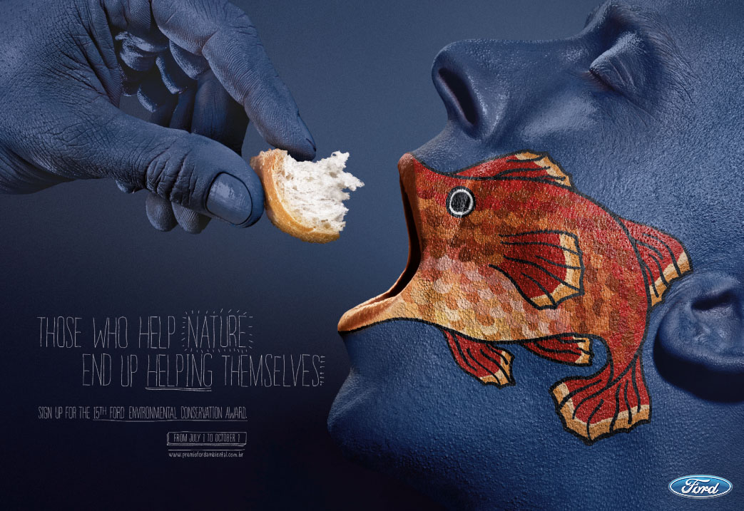
Learning Objective 2.3
Consumer behavior impacts directly on major public policy issues that confront our society.
Notes:
Some of the issues facing consumers include data privacy and identity theft, market access, and sustainability.

Slide 21
Data Privacy and Identity Theft (1 of 2)
Identity theft occurs when someone steals your personal information and uses it without your permission.
The Personal Data Notification & Protection Act of 2015
The Student Digital Privacy and Parental Rights Act of 2015
Notes:
Data breaches at major companies such as Target, Sony and Home Depot continue to worry
many people. The federal government is actively engaged with this problem and a variety of
legislative proposals are being considered including The Personal Data Notification &
Protection Act of 2015 that would strengthen the obligations companies have to notify
customers when their personal information has been exposed and The Student Digital
Privacy and Parental Rights Act of 2015 that would prevent companies from selling
K-12 students’ online data to third parties or otherwise sharing information unless it is for
a school-related purpose.

Slide 22
Data Privacy and Identity Theft (2 of 2)
Real time bidding
Phishing
Botnets
Locational Privacy
Notes:
Real-time bidding; an electronic trading system that sells ad space on the Web pages people click on at the moment they visit them.
Today, we increasingly fall prey to high-tech phishing scams in which people receive fraudulent emails that ask them to supply account information, as well as botnets (a set of computers that are penetrated by malicious software known as malware that allows an external agent to control their actions) that hijack millions of computers without any trace. Locational privacy is related to consumers that have GPS on their cell phones.

Slide 23
Market Access
Disabilities
Food deserts
Media literacy
Functionally illiterate
Notes:
Market access relates to the ability to find and purchase goods and services.
Disabled people are the largest minority market in the United States. One in 5 U.S. adults lives with a disability that interferes with daily life.
Food desert is a Census tract where 33 percent of the population or 500 people, whichever is less, live more than a mile from a grocery store in an urban area or more than 10 miles away in a rural area.
Media literacy refers to a consumer’s ability to access, analyze, evaluate, and communicate information in a variety of forms, including print and nonprint messages.
Functionally illiterate describes a person whose reading skills are not adequate to carry out everyday tasks, such as reading the newspaper or the instructions on a pill bottle.

Slide 24
Sustainability and Environmental Stewardship (1 of 2)
A triple bottom-line orientation refers to business strategies that strive to maximize return in three ways:
Financial
Social
Environmental

Slide 25

Sustainability and Environmental Stewardship (2 of 2)
Sustainability
Conscientious consumerism
Notes:
Conscientious consumerism relates to consumer’s focus on personal health is merging with a growing interest in global health.

Slide 26

Green Marketing and Greenwashing
Notes:
Green marketing describes a strategy that involves the development and promotion of environmentally friendly products and stressing this attribute when the
manufacturer communicates with customers.
Greenwashing occurs when companies make false or exaggerated claims about how environmentally friendly their products are.
LOHAS—an acronym for “lifestyles of health and sustainability.” This label refers to people who worry about the environment, want products to be produced in a sustainable way, and spend money to advance what they see as their personal development and potential.

Slide 27
Table 2.4 LOHAS Market Sectors (1 of 3)
Table 2.4 LOHAS Market Sectors
Personal Health | Green Building
$117 billion | $100 billion
Natural, organic products | Home certification
Nutritional products | Energy Star appliances
Integrative health care | Sustainable flooring
Dietary supplements | Renewable energy systems
Mind body spirit products | Wood alternatives
Notes:
LOHAS—an acronym for “lifestyles of health and sustainability.” This label refers to people who worry about the environment, want products to be produced in a sustainable way, and spend money to advance what they see as their personal development and potential.

Slide 28
Table 2.4 LOHAS Market Sectors (2 of 3)
[Table 2.4 continued]
Eco Tourism | Natural Lifestyles
$42 billion | $10 billion
Eco-tourism travel | Indoor & outdoor furnishings
Eco-adventure travel | Organic cleaning supplies
Blank | Compact fluorescent lights
Blank | Social change philanthropy
Blank | Apparel
Notes:
LOHAS—an acronym for “lifestyles of health and sustainability.” This label refers to people who worry about the environment, want products to be produced in a sustainable way, and spend money to advance what they see as their personal development and potential.

Slide 29
Table 2.4 LOHAS Market Sectors (3 of 3)
[Table 2.4 continued]
Alternative Transportation | Alternative Energy
$20 billion | $1 billion
Hybrid vehicles | Renewable energy credits
Biodiesel fuel | Green pricing
Car sharing programs | Blank
Source: lohas.com accessed March 2, 2013.
Notes:
LOHAS—an acronym for “lifestyles of health and sustainability.” This label refers to people who worry about the environment, want products to be produced in a sustainable way, and spend money to advance what they see as their personal development and potential.

Slide 30
For Reflection (3 of 4)
Would you prefer to purchase from a restaurant that composts?
What are some sustainable methods used in your workplace?

Slide 31
Learning Objective 2.4
Consumer behavior can be harmful to individuals and to society.

Slide 32

Consumer Terrorism
Cyberterrorism
Guerrilla marketing
Notes:
Consumer Terrorism Consumers may suffer from attacks from others,
Cyberterrorism is the politically motivated use of computers and information technology to cause severe disruption or widespread fear in society.
Guerrilla marketing is an innovative, unconventional, and low-cost marketing techniques aimed at obtaining maximum exposure for a product.

Slide 33
Addictive Consumption
Consumer addiction
Social media addiction
Cyberbullying
Phantom Vibration Syndrome
Compulsive consumption
Notes:
Addictive Consumption may become addicted to products,
Social media consumption is compared to chemical dependency.
Cyberbullying refers to the “willful and repeated harm inflicted through the use of computer, cell phones, and other electronic devices.
Phantom Vibration Syndrome describes the tendency to habitually reach for your cell phone because you feel it vibrating, even if it is off or you are not even wearing it at the time.
Compulsive Comsumption refers to repetitive and often excessive shopping performed as an antidote to tension, anxiety, depression, or boredom.

Slide 34
Dark Side of CB
Consumed consumers
Illegal acquisition and product use
Consumer theft and fraud
Shrinkage
Serial wardrobers
Counterfeiting
Anticonsumption
Notes:
Consumed Consumers and may even become products themselves. Consumed consumers are people who are used or exploited, willingly or not, for commercial
gain in the marketplace. Examples – prostitutes, selling babies, blood, organ and hair donors, surrogate mothers being paid to carry other people’s children.
Shrinkage is the industry term for inventory and cash losses from shoplifting and employee theft.
Serial wardrobers “who buy an outfit, wear it once, and return it”; customers who change price tags on items, then return one item for the higher amount; and shoppers who use fake or old receipts when they return a product.
Counterfeiting is when companies or individuals sell fake versions of real products to customers.
Anticonsumption relates to events in which people deliberately deface or mutilate products and services.

Slide 35
For Reflection (4 of 4)
Do you know someone who is addicted to social media? In what way?
If you work in retail, have you experienced consumers habitually returning items?

Slide 36
For Review
Ethical business is good business.
Marketers have an obligation to provide safe and functional products as part of their business activities.
Consumer behavior impacts directly on major public policy issues that confront our society.
Consumer behavior can be harmful to individuals and to society.

Slide 37

Copyright

